Slide 1

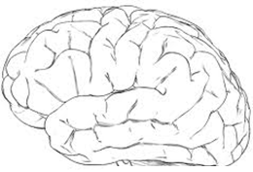

Brains, Data, and Machine Intelligence
Catalyst for machine intelligence
Research Neocortical theory Algorithms
NuPIC Open source community
Products
Automated streaming analytics
Jeff Hawkins
jhawkins@numenta.com
Notes:
I assume some knowledge of SDRs and CLA
This talk is more speculative than most

Slide 2
“If you invent a breakthrough so computers can learn, that is worth 10 Microsofts”
Notes:
Matt

Slide 3
"If you invent a breakthrough so computers that learn that is worth 10 Micros
Machine Intelligence
What principles will we use to build intelligent machines?
What applications will drive adoption in the near and long term?
Notes:
Matt

Slide 4
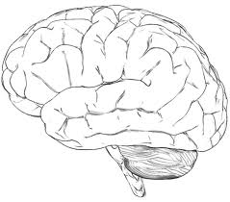
Machine intelligence will be built on the principles of the neocortex
Flexible (universal learning machine)
Robust
If we knew how the neocortex worked, we would be in a race to build them.
Notes:
Matt

Slide 5
What the Cortex Does
retina
The neocortex learns a model from sensory data
- predictions - anomalies - actions
data stream
cochlea
somatic
The neocortex learns a sensory-motor model of the world

Slide 6
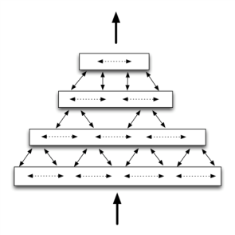
“Hierarchical Temporal Memory” (HTM)
1) Hierarchy of nearly identical regions
- across species
- across modalities
retina
data stream
cochlea
somatic
2) Regions are mostly sequence memory
- for inference
- for motor
3) Feedforward: Temporal stability
Feedback: Unfold sequences

Slide 7
Cortex
2.5 mm
2/3
Layers
4
5
6
Cortical Learning Algorithm (CLA)
2/3
Sequence memory: high-order inference
Layers & Columns
4
Sequence memory: sensory-motor inference
5
Sequence memory: motor generation
6
Sequence memory: attention
CLA is a cortical model, not another “neural network”

Slide 8
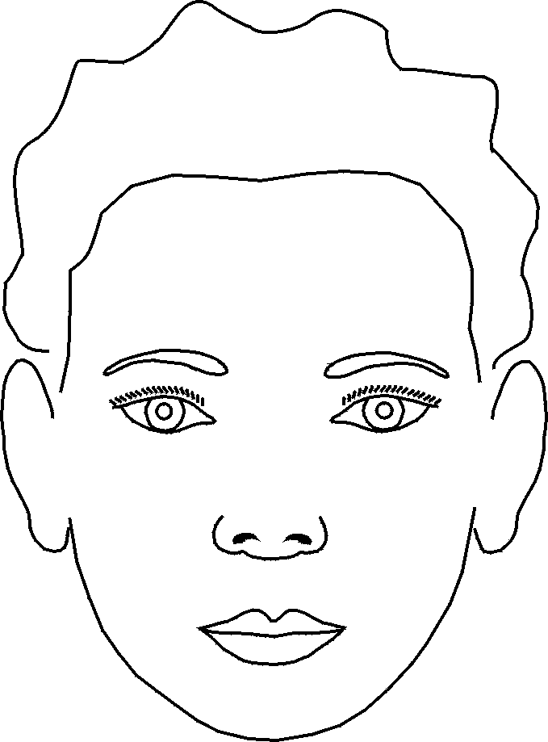
L4 and L2/3: Feedforward Inference
2/3
Pass through
changes
Un-predicted
A-B-C-D X-B-C-Y
A-B-C- ? D X-B-C- ? Y
Learns high-order transitions
Stable
Predicted
4
Learns sensory-motor transitions
5
6
Sensor/afferent data
Next higher region
Copy of motor commands
Layer 4 learns sensory-motor transitions.
Layer 3 learns high-order transitions.
These are universal inference steps.
They apply to all sensory modalities.

Slide 9
L5 and L6: Feedback, Behavior and Attention
2/3
Learns high-order transitions
Well understood
tested / commercial
Feedforward
4
Learns sensory-motor transitions
90% understood
testing in progress
5
Recalls motor sequences
50% understood
Feedback
6
Attention
10% understood

Slide 10
How does a layer of neurons learn sequences?
Cortical Learning Algorithm (CLA)
2/3
Learns high-order transitions
4
5
6
First:
- Sparse Distributed Representations
- Neurons

Slide 11
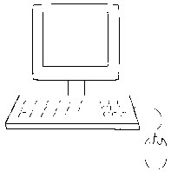

Dense Representations
Few bits (8 to 128)
All combinations of 1’s and 0’s
Example: 8 bit ASCII
Bits have no inherent meaning Arbitrarily assigned by programmer
01101101 = m
Sparse Distributed Representations (SDRs)
Many bits (thousands)
Few 1’s mostly 0’s
Example: 2,000 bits, 2% active
Each bit has semantic meaning Learned
01000000000000000001000000000000000000000000000000000010000…………01000

Slide 12
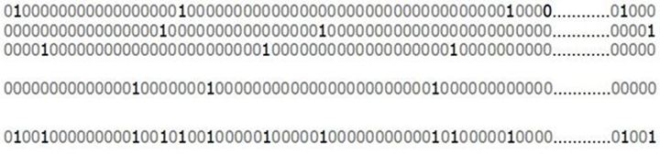
SDR Properties
1) Similarity: shared bits = semantic similarity
2) Store and Compare: store indices of active bits
Indices 1 2 3 4 5 | 40
subsampling is OK
Indices 1 2 | 10
3) Union membership:
1) 2) 3)
2%
….
10)
Union
20%
Is this SDR a member?

Slide 13
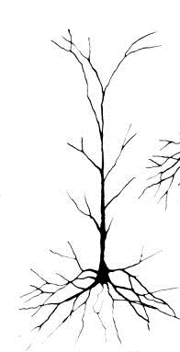
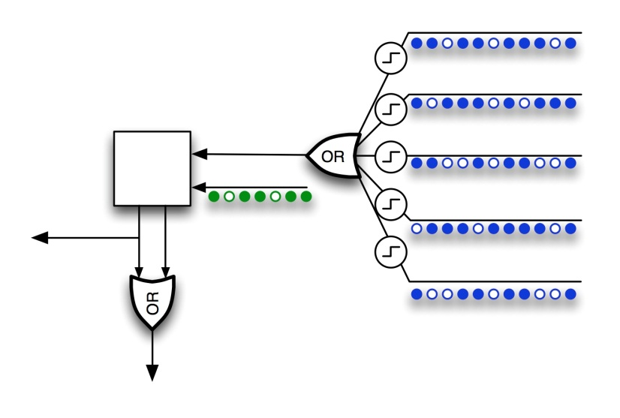
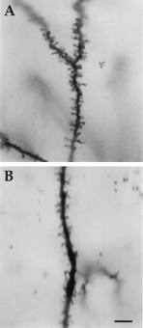
Neurons
Active Dendrites
Pattern detectors
Each cell can recognize
100’s of unique patterns
Feedforward
100’s of synapses
“Classic” receptive field
Model neuron
Context
1,000’s of synapses
Depolarize neuron
“Predicted state”

Slide 14
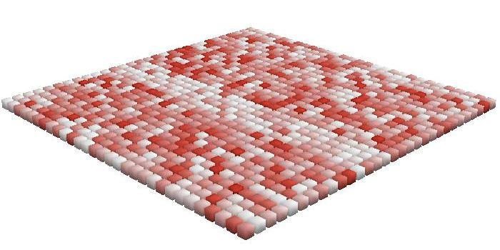
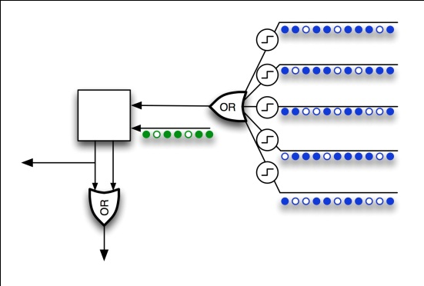
Learning Transitions
Feedforward activation

Slide 15
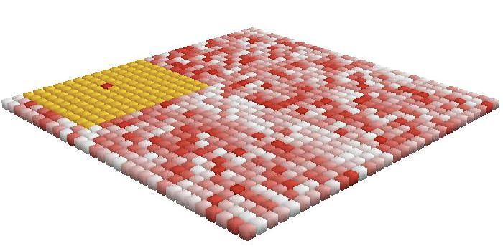
Learning Transitions
Inhibition

Slide 16
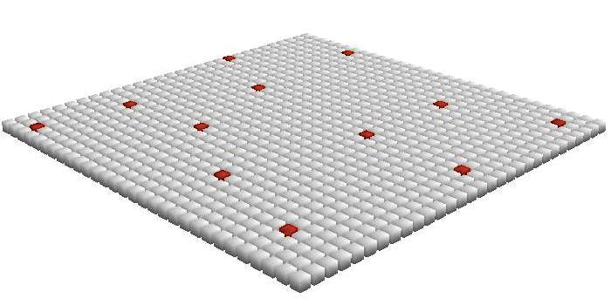
Learning Transitions
Sparse cell activation

Slide 17
Time = 1
Learning Transitions

Slide 18
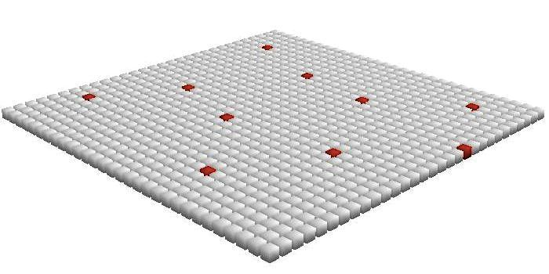
Time = 2
Learning Transitions

Slide 19
Learning Transitions
Form connections to previously active cells.
Predict future activity.

Slide 20
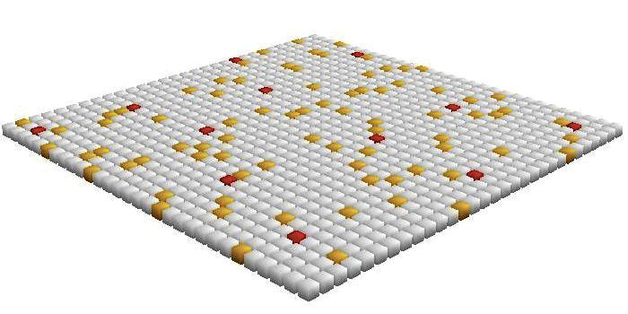
Learning Transitions
Multiple predictions can occur at once.
A-B A-C A-D
This is a first order sequence memory.
It cannot learn A-B-C-D vs. X-B-C-Y.

Slide 21
High-order Sequences Require Mini-columns
A-B-C-D vs. X-B-C-Y
X
B’’
C’’
Y’’
A
B’
C’
Before training
X
B
C
Y
A
B
C
D

Slide 22
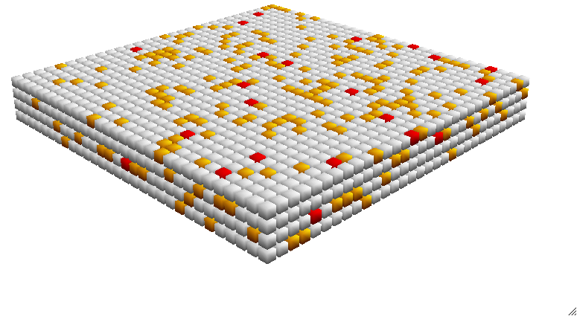
Cortical Learning Algorithm (CLA)
aka Cellular Layer
Converts input to sparse representations in columns
Learns transitions
Makes predictions and detects anomalies
Applications 1) High-order sequence inference L2/3
2) Sensory-motor inference L4
3) Motor sequence recall L5
Capabilities - On-line learning
- High capacity
- Simple local learning rules
- Fault tolerant
- No sensitive parameters
Basic building block of neocortex/machine intelligence

Slide 23
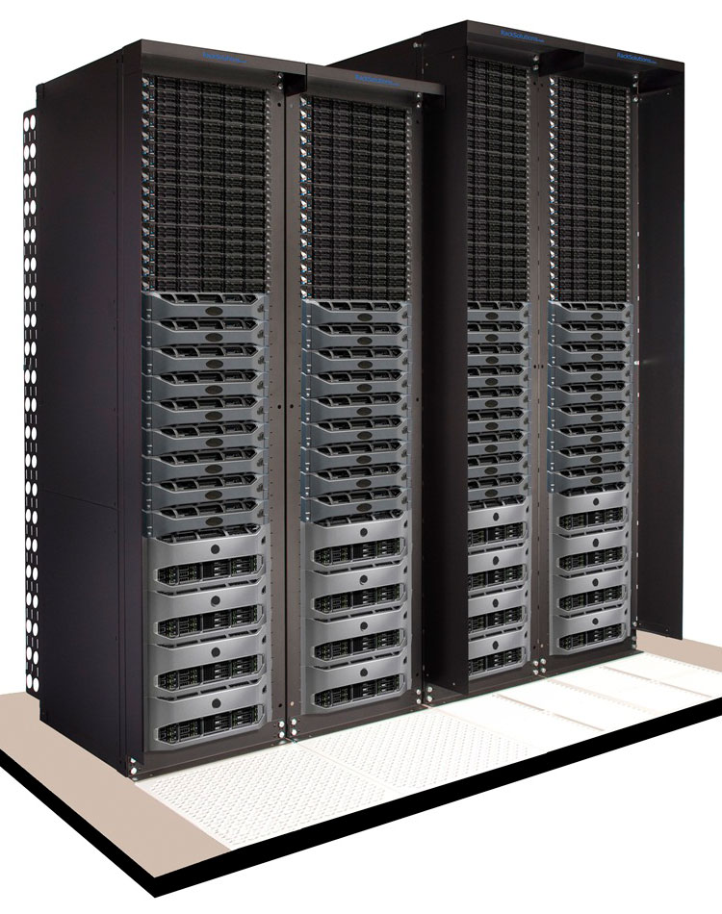
Anomaly Detection Using CLA
CLA
Metric + Time
Encoder
SDR
Prediction error
Time average
Historical comparison
Anomaly score
. . .
CLA
Metric + Time
Encoder
SDR
Prediction error
Time average
Historical comparison
Anomaly score

Slide 24
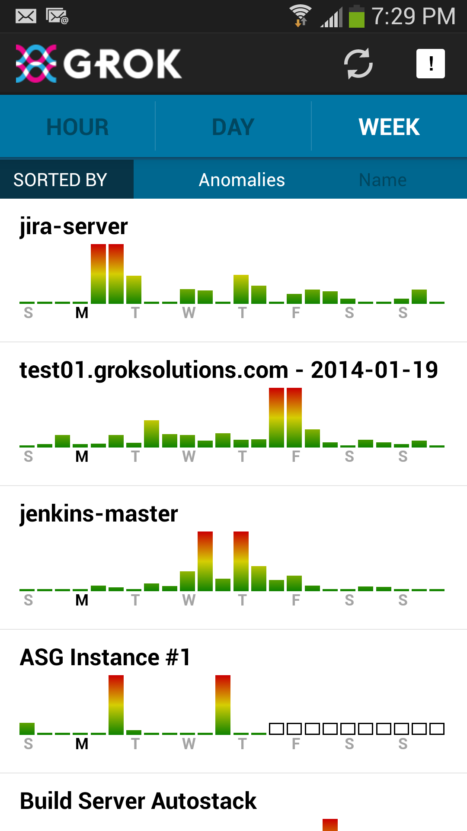
Grok for AWS Users
Customer Instances & Services
CloudWatch
AWS
- Automated model creation via web, CLI, API
- Breakthrough anomaly detection
- Dramatically reduces false positives/negatives
- Supports auto-scaling and custom metrics
- Mobile client
- Instant status check
- Mobile OS and email alerts
- Drill down to determine severity

Slide 25
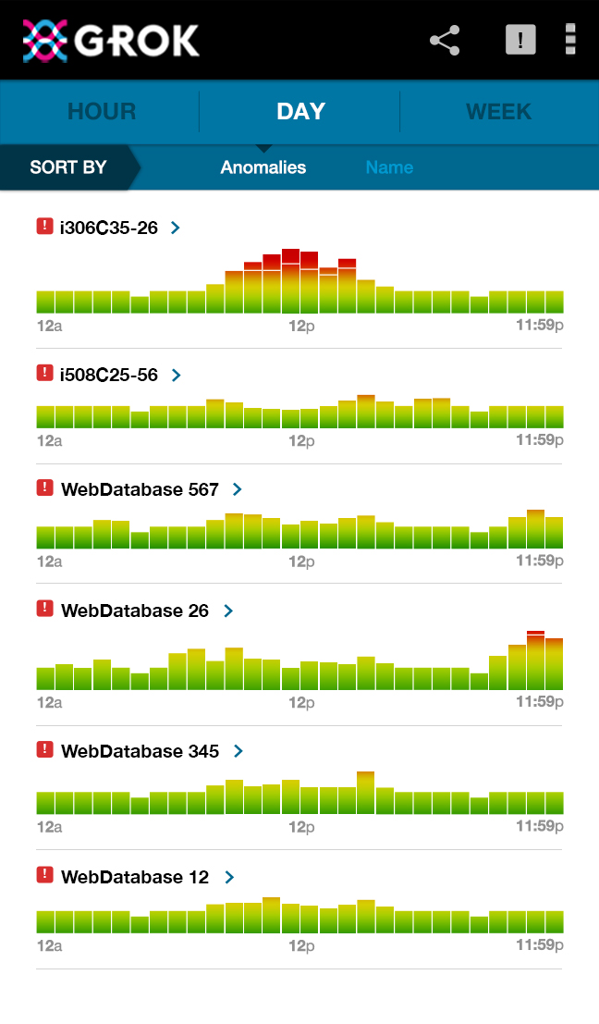
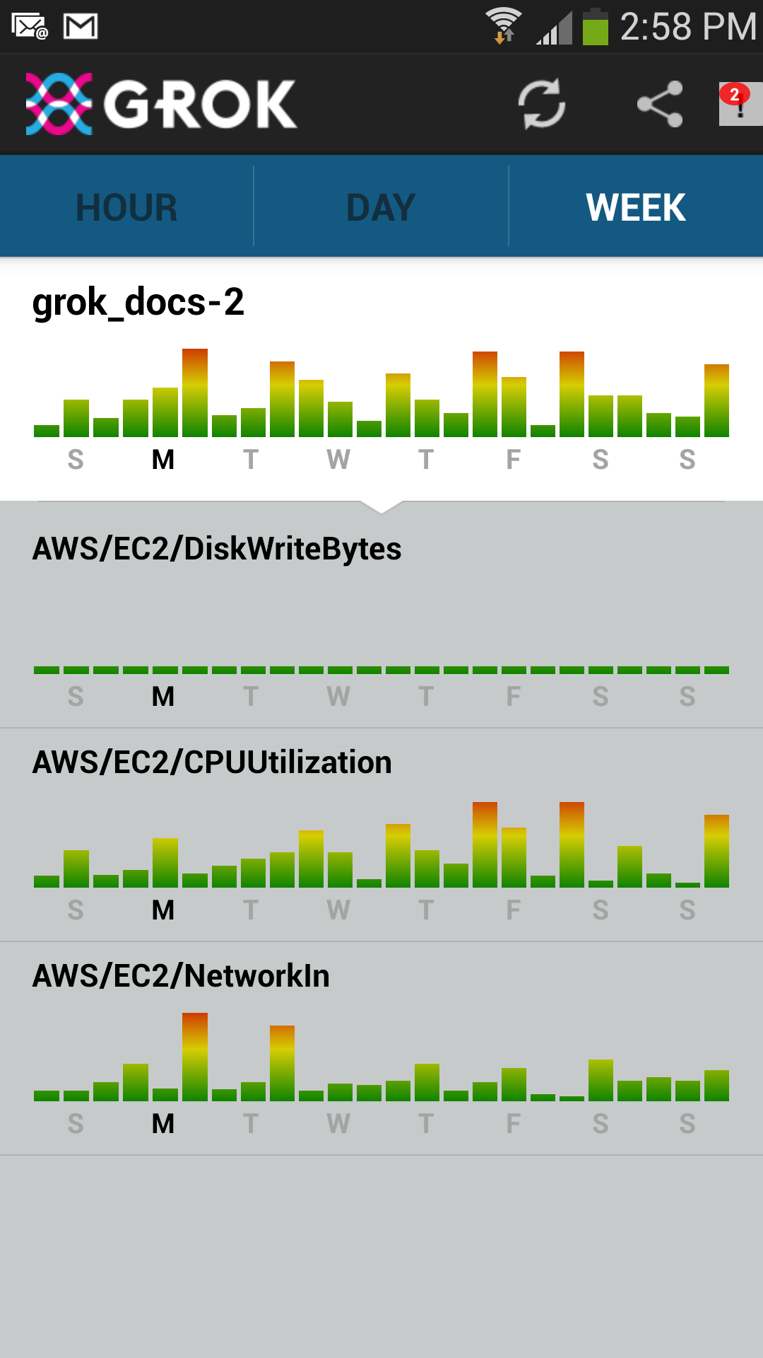
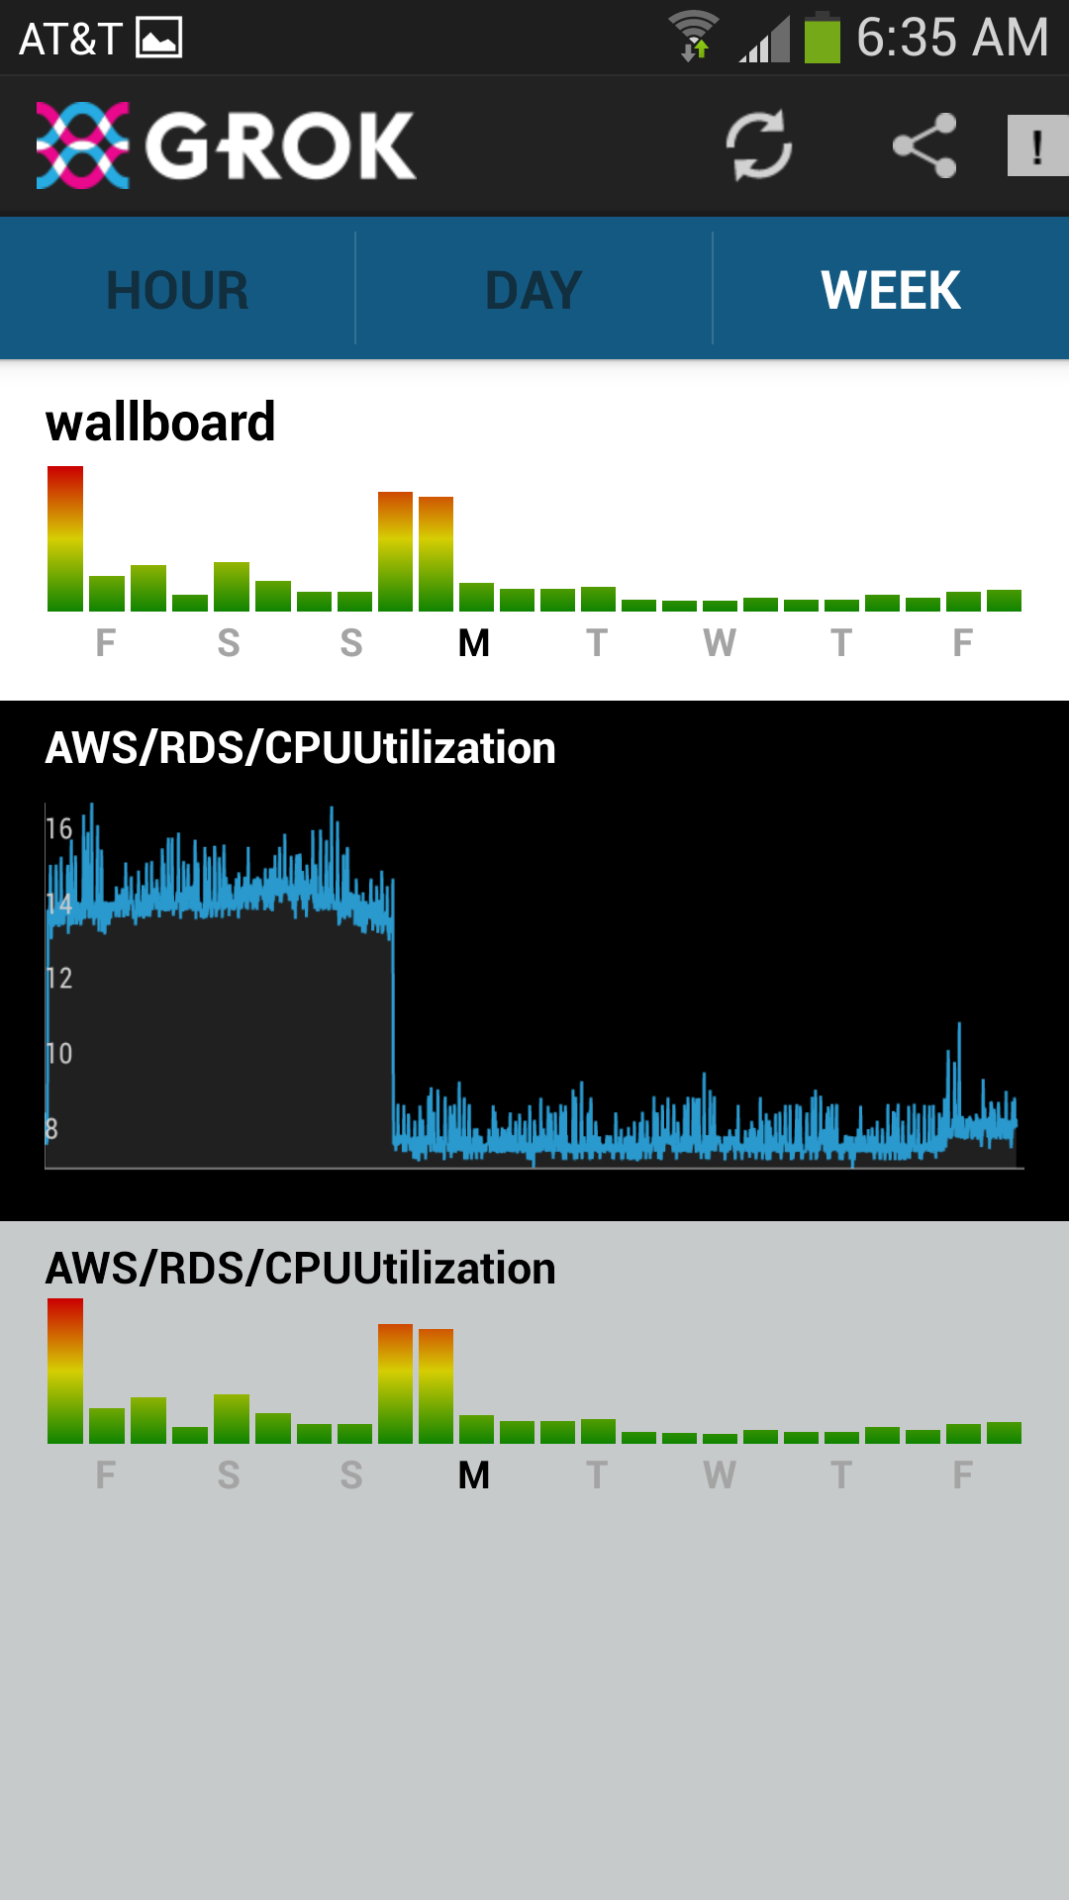
Grok for AWS Mobile UI
Sorted by anomaly score
Continuously updated
Continuously learning

Slide 26
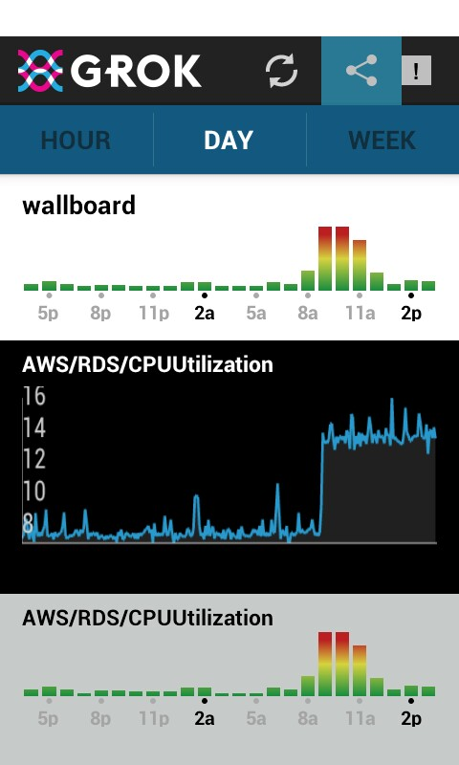
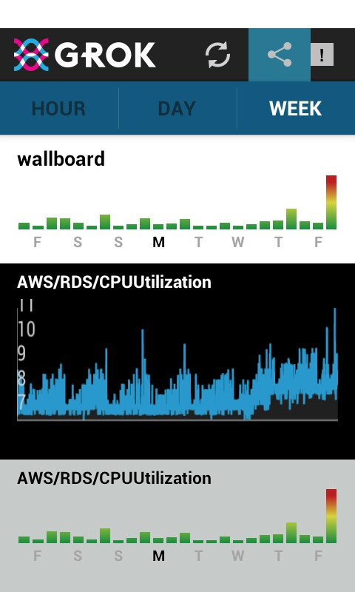
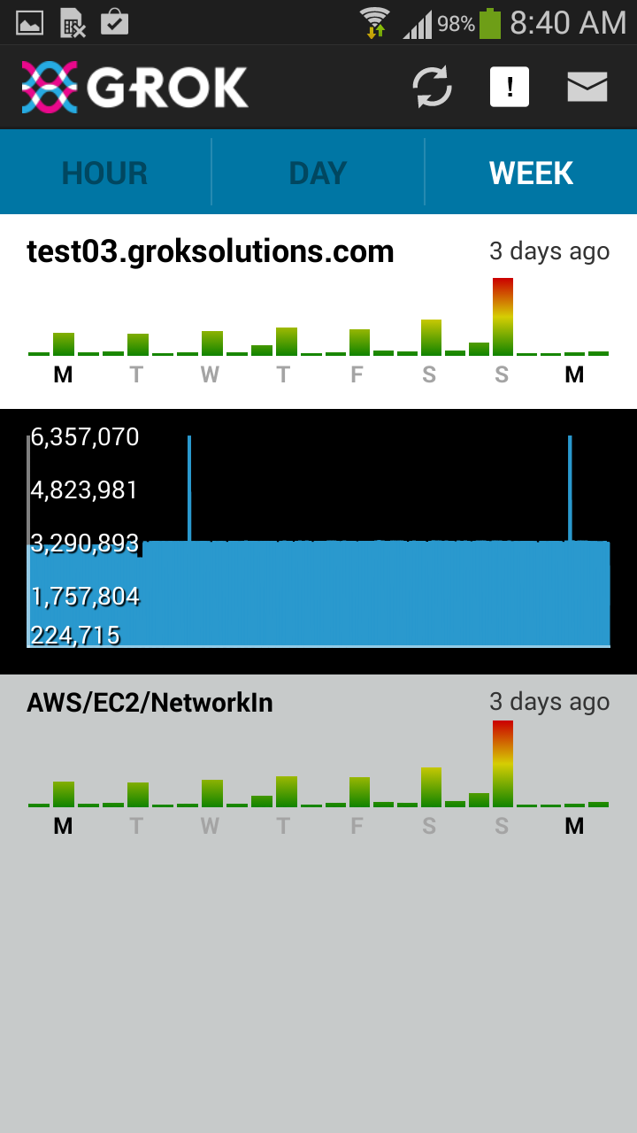
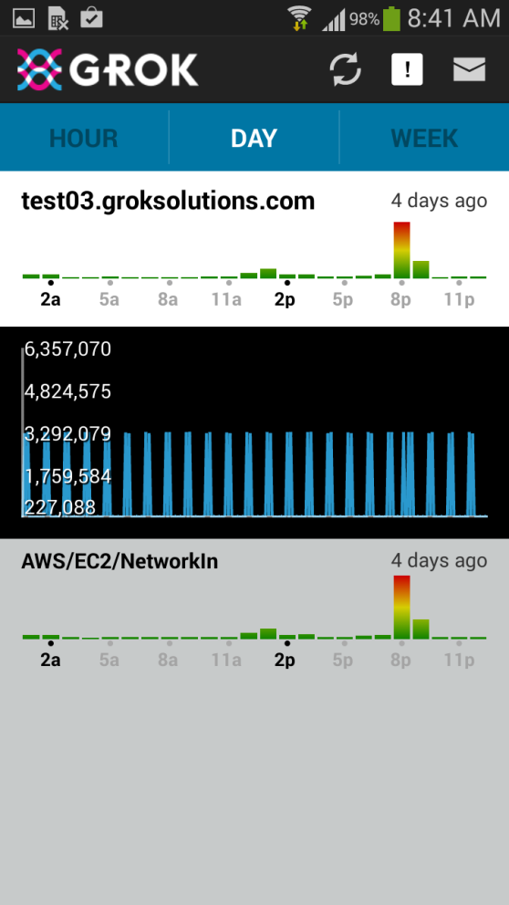
What Can the CLA/Grok Detect?
Sudden changes
Slow changes
Subtle changes in regular data

Slide 27
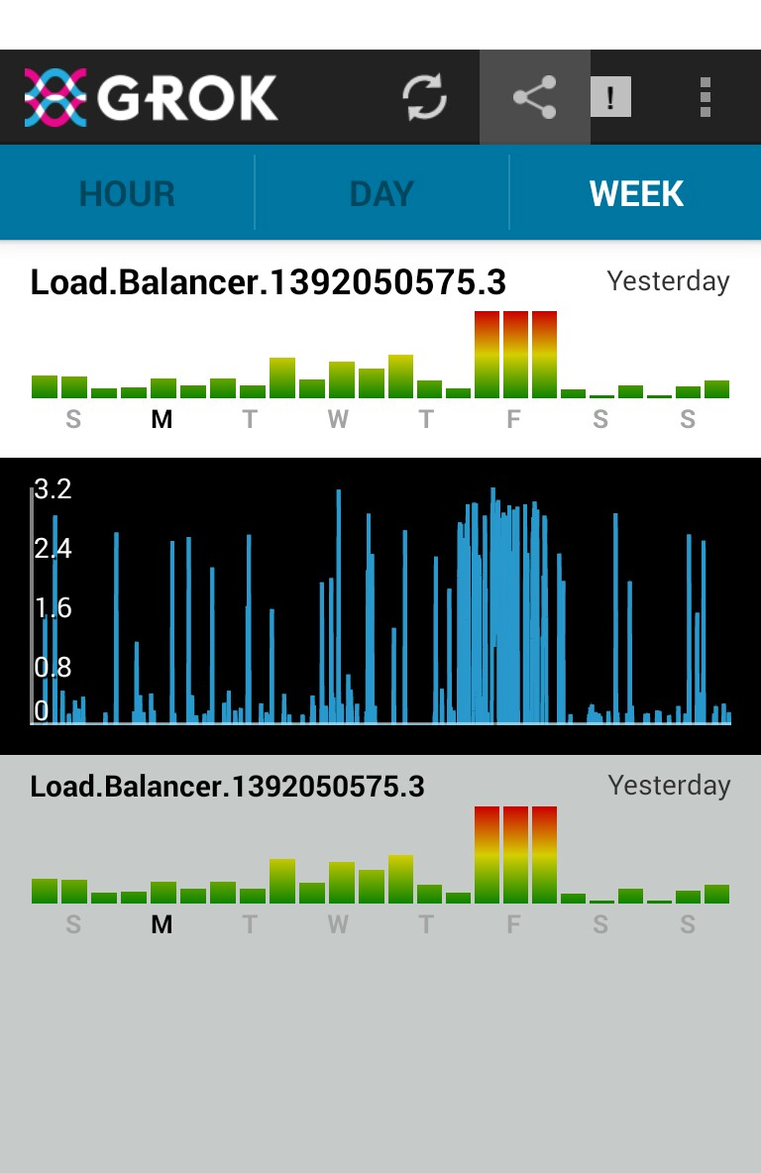
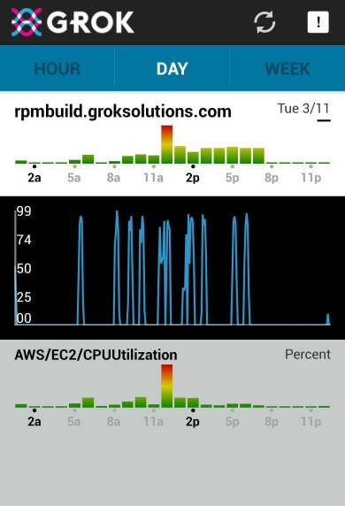
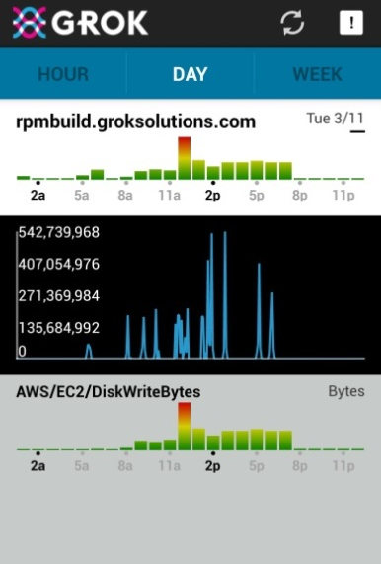
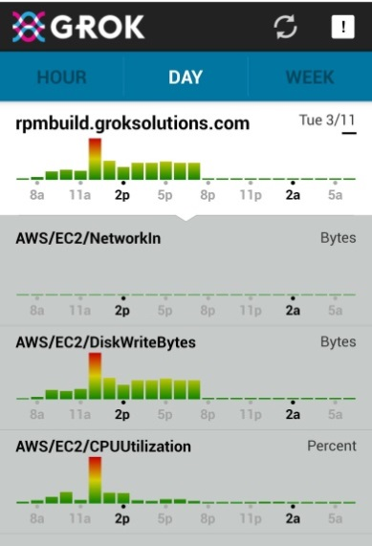
What Can the CLA/Grok Detect?
Changes in noisy data
Patterns that humans can’t see

Slide 28
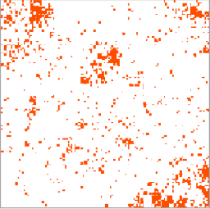
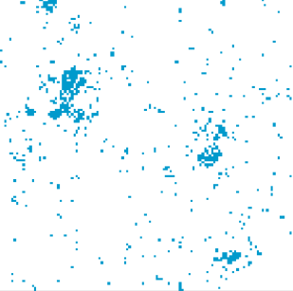
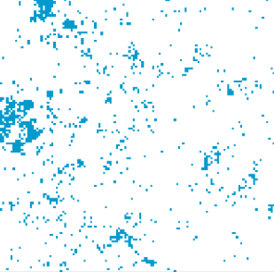
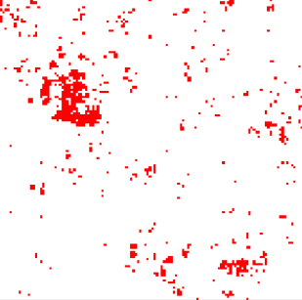
CEPT.at - Natural Language Processing Using SDRs and CLA
100K “Word SDRs”
Document corpus (e.g. Wikipedia)
128 x 128
Apple
-
Fruit
Computer
Macintosh
Microsoft
Mac
Linux
Operating system
….
=

Slide 29
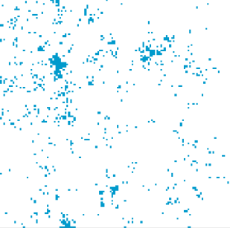
Sequences of Word SDRs
Training set
frog | eats | flies
cow | eats | grain
elephant | eats | leaves
goat | eats | grass
wolf | eats | rabbit
cat | likes | ball
elephant | likes | water
sheep | eats | grass
cat | eats | salmon
wolf | eats | mice
lion | eats | cow
dog | likes | sleep
elephant | likes | water
cat | likes | ball
coyote | eats | rodent
coyote | eats | rabbit
wolf | eats | squirrel
dog | likes | sleep
cat | likes | ball
---- | ---- | -----
Word 1
Word 2
Word 3

Slide 30
Sequences of Word SDRs
Training set
frog | eats | flies
cow | eats | grain
elephant | eats | leaves
goat | eats | grass
wolf | eats | rabbit
cat | likes | ball
elephant | likes | water
sheep | eats | grass
cat | eats | salmon
wolf | eats | mice
lion | eats | cow
dog | likes | sleep
elephant | likes | water
cat | likes | ball
coyote | eats | rodent
coyote | eats | rabbit
wolf | eats | squirrel
dog | likes | sleep
cat | likes | ball
---- | ---- | -----
“fox”
eats
?

Slide 31
Sequences of Word SDRs
Training set
frog | eats | flies
cow | eats | grain
elephant | eats | leaves
goat | eats | grass
wolf | eats | rabbit
cat | likes | ball
elephant | likes | water
sheep | eats | grass
cat | eats | salmon
wolf | eats | mice
lion | eats | cow
dog | likes | sleep
elephant | likes | water
cat | likes | ball
coyote | eats | rodent
coyote | eats | rabbit
wolf | eats | squirrel
dog | likes | sleep
cat | likes | ball
---- | ---- | -----
“fox”
eats
rodent
Word SDRs created without supervision
Semantic generalization SDR: lexical CLA: grammatic
Commercial applications Sentiment analysis Abstraction Improved text to speech Dialog, Reporting, etc. www.Cept.at

Slide 32
Cept and Grok use exact same code base
“fox”
eats
rodent

Slide 33
NuPIC Open Source Project
Source code for: - Cortical Learning Algorithm - Encoders - Support libraries
Single source tree (used by GROK), GPLv3
Active and growing community
Hackathons
Education Resources
www.Numenta.org

Slide 34
Goals For 2014
Research
- Implement and test L4 sensory/motor inference - Introduce hierarchy (?) - Publish
NuPIC
- Grow open source community - Support partners, e.g. IBM, CEPT Grok
- Create commercial value for CLA Attract resources Provide a “target” and market for HW - Explore new application areas

Slide 35
The neocortex is as close to a universal learning machine as we can imagine
Machine intelligence will be built on the principles of the neocortex
HTM is an overall theory of neocortex
CLA is a building block
Near term applications anomaly detection, prediction, NLP
Participate www.numenta.org
Notes:
Matt

Slide 36
Notes:
Matt

Slide 37
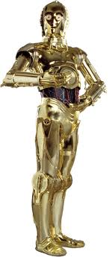
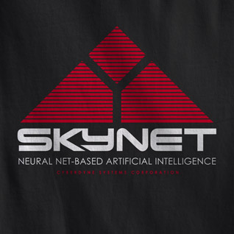
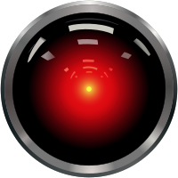
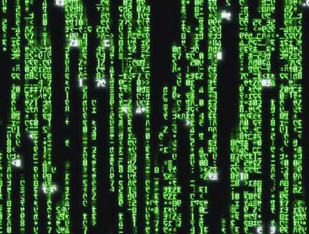
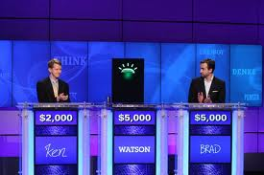
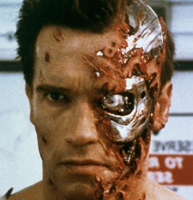
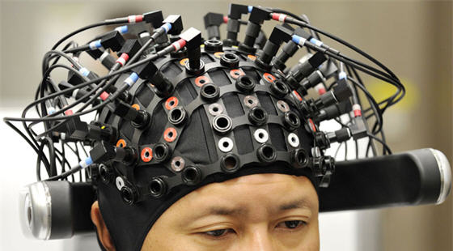
Future of Machine Intelligence

Slide 38
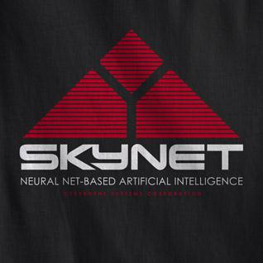
Future of Machine Intelligence
Definite
Faster, Bigger
Super senses
Fluid robotics
Distributed hierarchy
Maybe
Humanoid robots
Computer/Brain interfaces for all
Not
Uploaded brains
Evil robots
Notes:
People liked this. Should I have something like this up front?

Slide 39
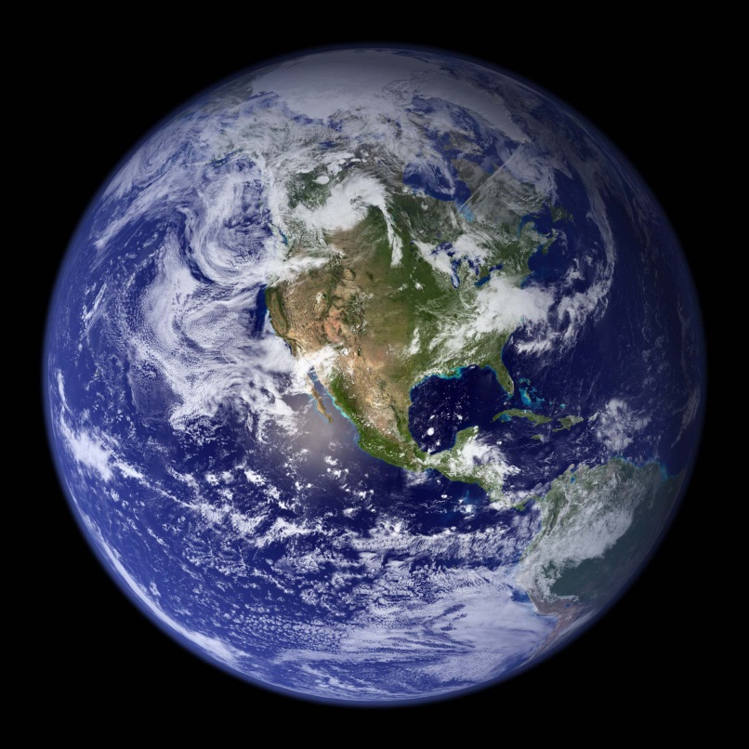
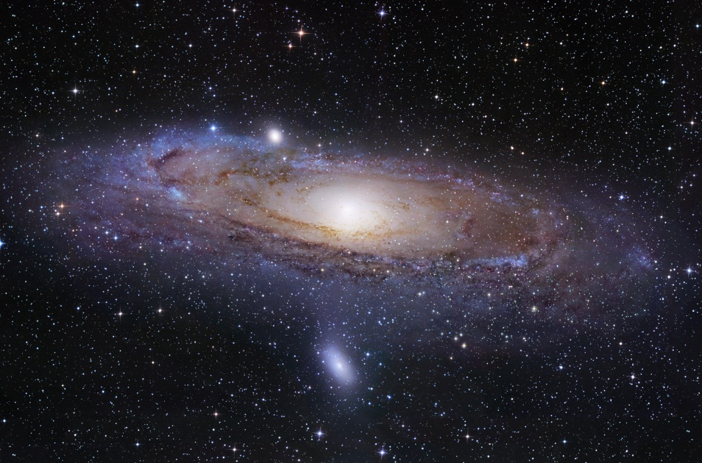
Why Create Intelligent Machines?
Live better
Learn more
Thank You
Notes:
Opposite sex?

